Slide 1

MEDO-MEDIC ALERT
Never Forget Your Medicine
By
1.Vignesh J
2.SasiKumar.N
3.Saravanakumar.M
R.M.K ENGINEERING COLLEGE
ECE DEPARTMENT

Slide 2
Problem & Solution
Most people would prefer to live in their own homes in their old age, rather than in nursing homes.
But living independently can be scary when a fall or a medical emergency could mean a one-way trip to the hospital
So to overcome this problem we have made MEDO a medication alert app for older ones which can make independent live safer.

Slide 3
MEDO-Abstract:
Medo is a medication alert application used for giving alerts to aged peoples to remind of about their intake of medicines
The Application gives a text to Speech description reminder about their medicine as prescribed by the doctor
The App is compatible with all Android version above 4.0 & it can also made compatible with wearable devices

Slide 4
MEDO FEATURES
Big buttons and text fields make the App very easy to use.
The App could be use by everyone but is especially prepared for aged people
Define as many medicines as they need & text to speech feature will help person with sight disability
They can also add a description about each of their medicines.

Slide 5
USERS OF MEDO
People with absent minded can use MEDO
Aged People with sight disability
Office going individual can make a reminder alert for their aged parents to take of medicines using Medo

Slide 6
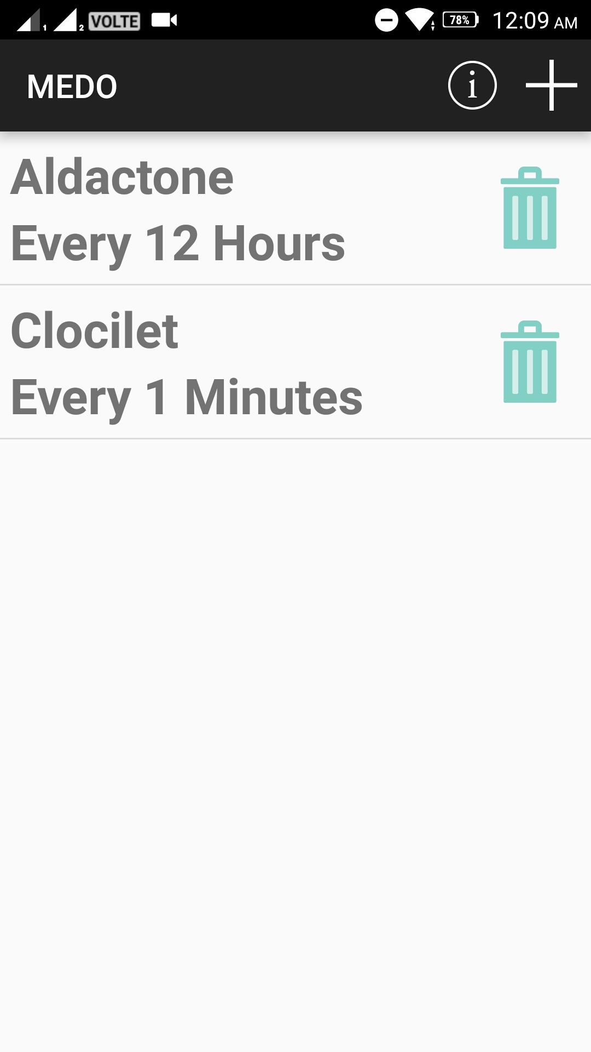
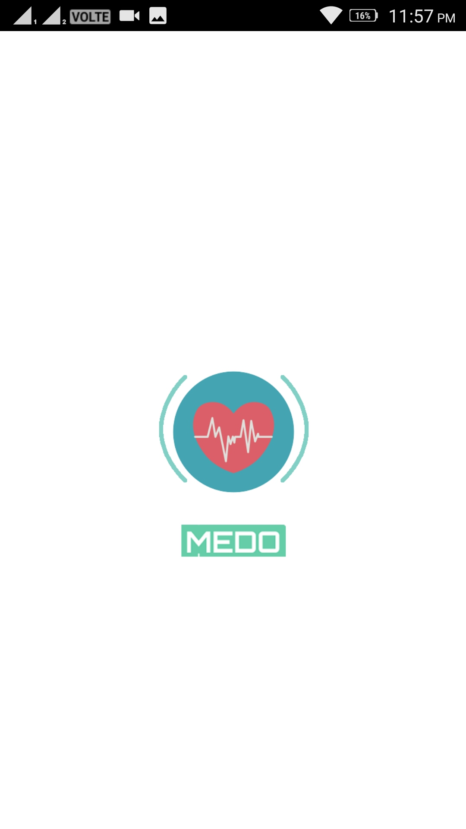
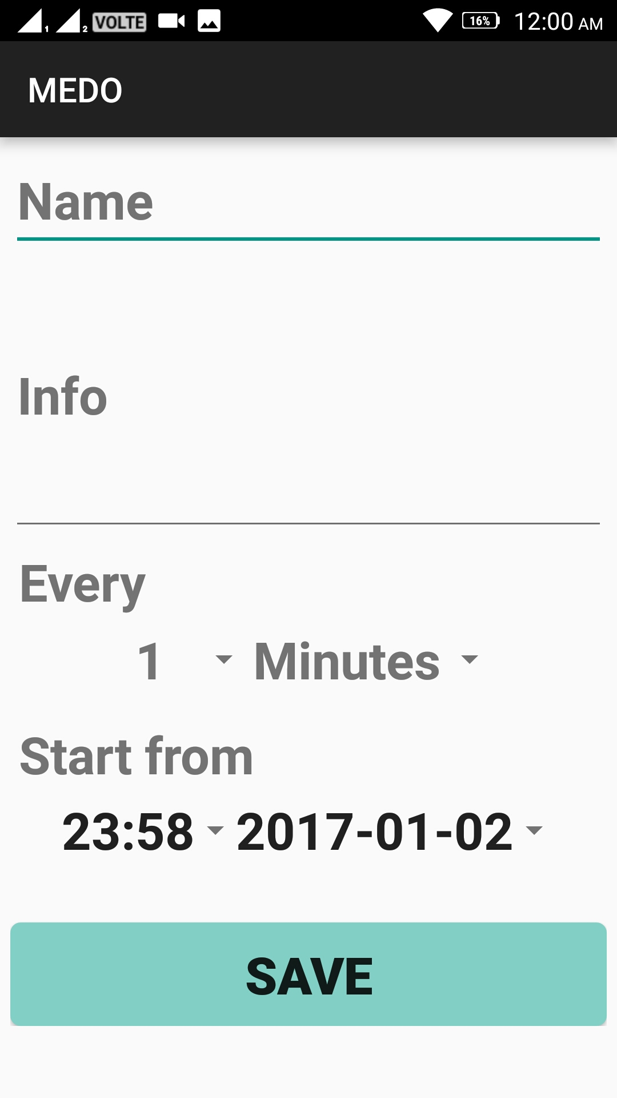
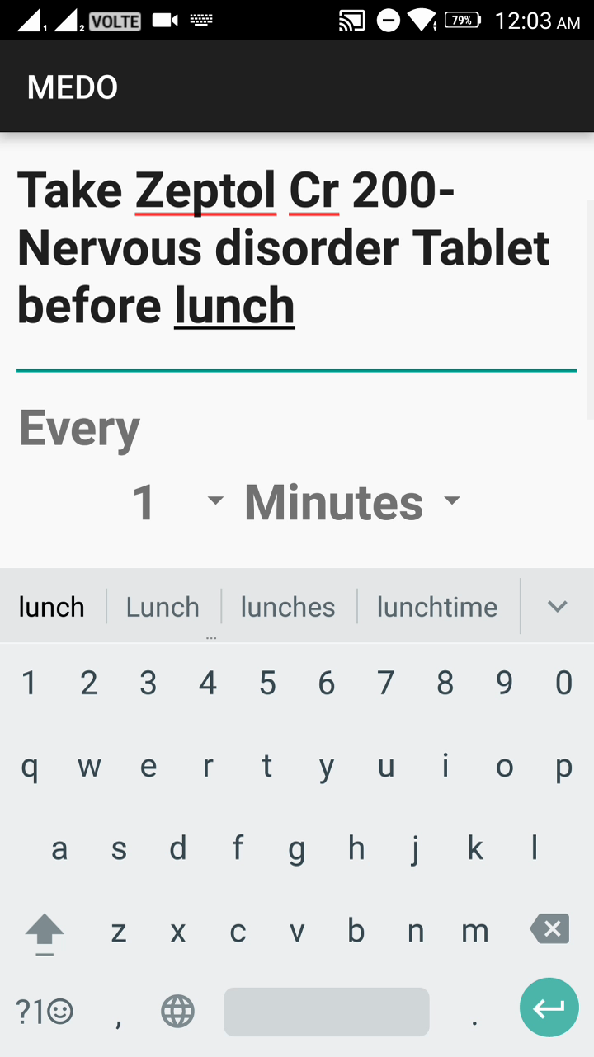
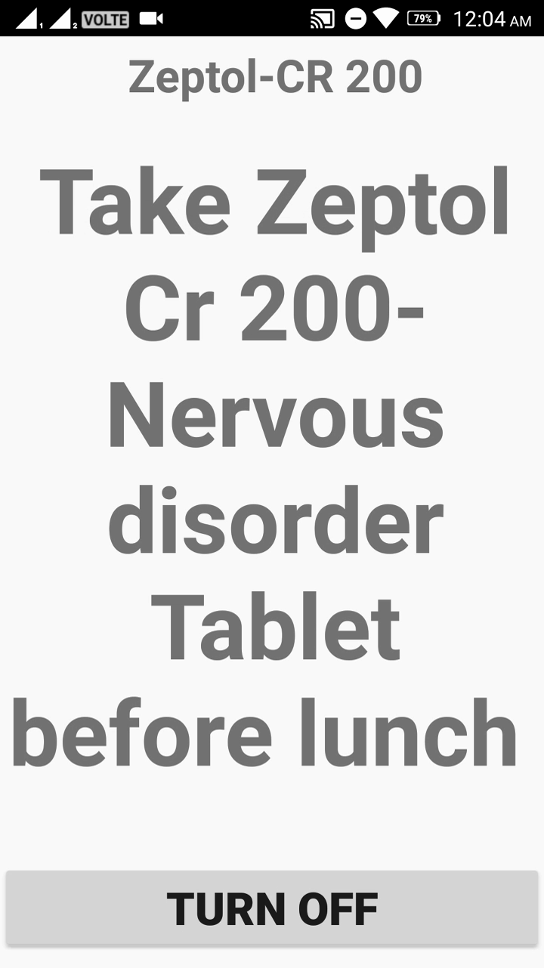
MEDO SCREENSHOTS

Slide 7
MEDO WORKING VIDEO

Slide 8
MEDO- Never Forget Your Medicine THANK YOU
CONCLUSION

